Slide 1
Project presentation 1
Attend-in (Group 8)
Group members: Duc Pham, Hien(Jason) Tran, Md Rifat Uddin, Jalen Davis
Instructor: William Gregory Johnson

Slide 2
What is Attend-in?
A web application allows students to take attendance with their Laptops and phones
BUT only if they are within proximity of their classroom
Possible feature: Allow professors to download attendance information to their devices

Slide 3
TECH PLATFORM?
Back-end: Python in FastAPI web framework.
Front-end: JavaScript, HTML, CSS, React.Js
Database: MySQL(storage), Redis(caching).
Network: WebSocket
Tools: Vscode, Navicat (database), Postman (testing API)

Slide 4
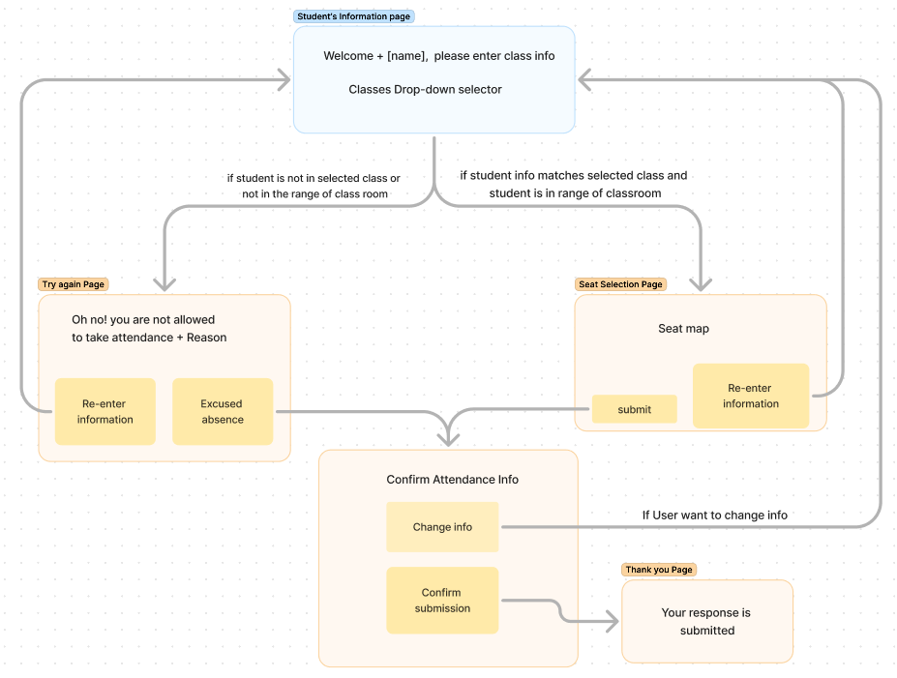
Storyboard 1: User-view of our app
White board
Seat map layout

Slide 5
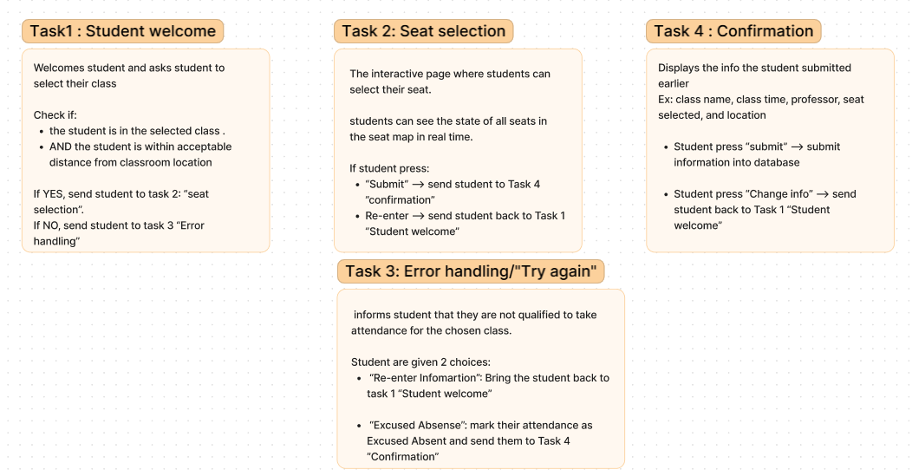
Story cards 1: User view

Slide 6
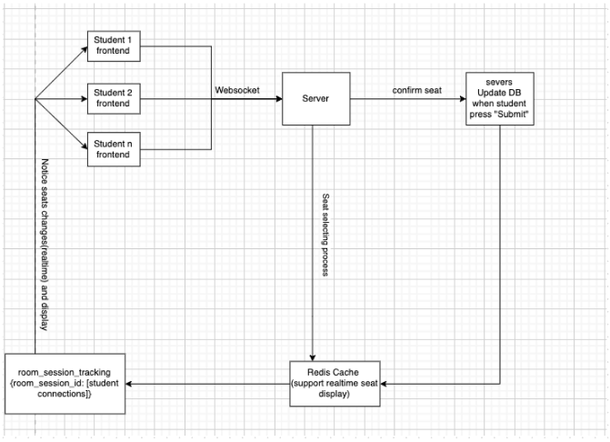
Storyboard 2: How our seat map works

Slide 7
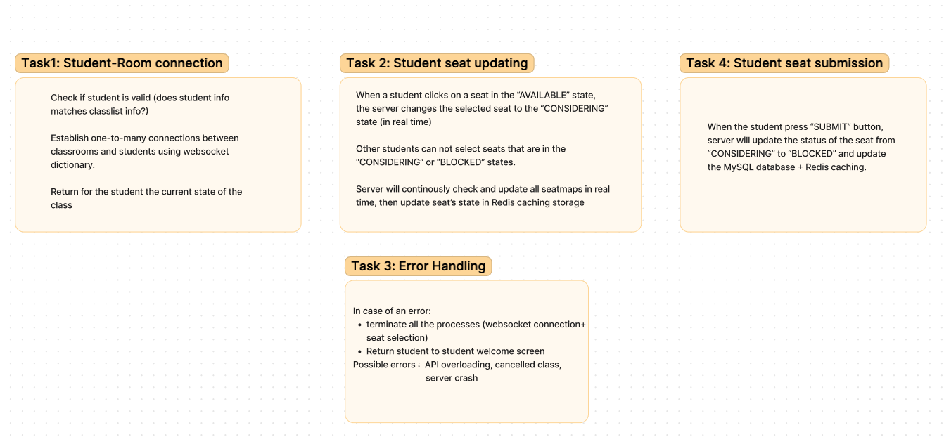
Story cards 2: How our Seat map works

